Slide 1
Towards Trustworthy Federated Learning
Against Poisoning Attacks
Sungwon Park*, Sungwon Han*, Fangzhao Wu, Sundong Kim,
Bin Zhu, Xing Xie, Meeyoung Cha
Notes:
10s
Hi everyone! Thanks for coming to this talk. I am Sungwon Park from KAIST.
Our work is titled, “FedDefender: Client-Side Attack-Tolerant Federated Learning”

Slide 2
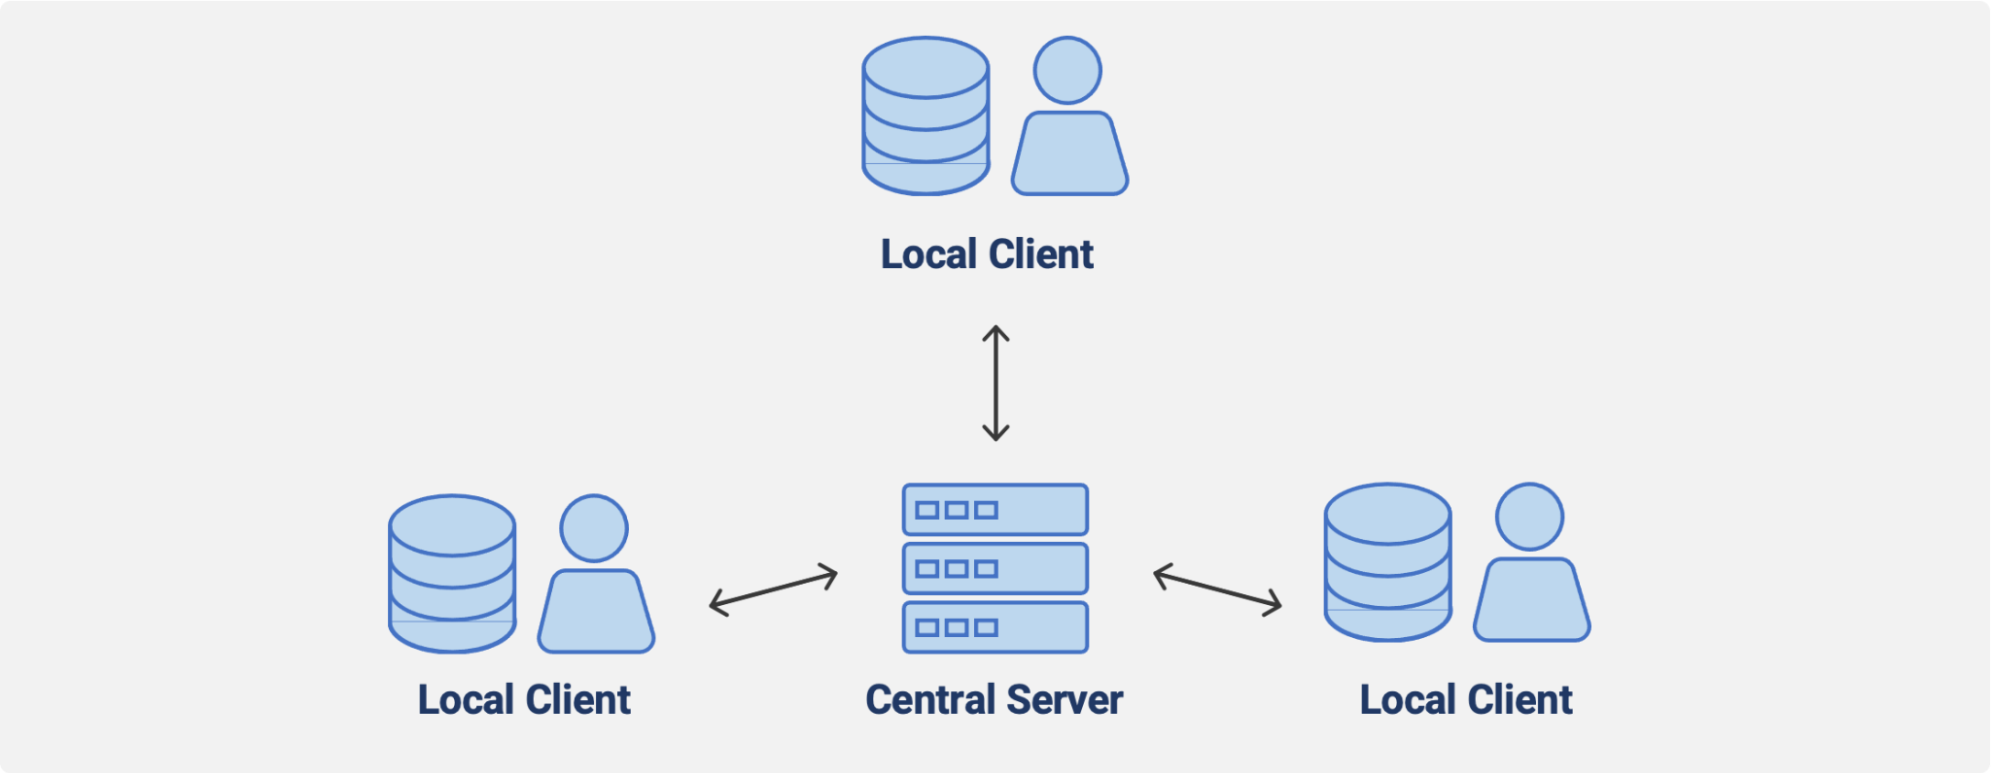
Background
Federated learning
Concerns on user data privacy and confidentiality.
Inability to build an ML model due to inadequate data or training cost on ML implementation of the computational cost involved for training an ML model.
Notes:
Most deep learning models assume unlimited access to data during training.
However, this assumption does not hold true in modern distributed systems where data privacy is of utmost importance.
For instance, sensitive data such as that stored in hospitals or on mobile devices cannot be shared.
To address this issue, a new approach called Federated Learning has been proposed in recent times.
Federated Learning is a collaborative approach to building a shared global model by training local models on decentralized datasets.

Slide 3
Background
Federated learning: problem statement
Assume that data are distributed over every different local client.
Clients aim to train a single model F that can apply for global distribution tasks with the help of central server.
Then, the global objective function to solve is as follows:
Notes:
Here is the problem statement of federated learning.
We assume that data are distributed over every different clients.
And local parties aim to train a single model F that can apply for global distribution tasks with the help of central server.
Then, we try to minimize the global objective function which is the sum of every local party.

Slide 4
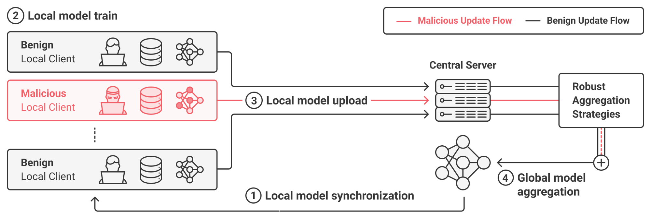
Vulnerability in FL
Federated learning can be broken by adversaries
Adversaries can send perturbed gradient to server, poisoning the learning process
Notes:
The main process of conventional federated system framework is as follows:
First of all, the server sends a global model to the clients.
Then, the clients locally train their models via stochastic gradient descent.
After that, the local models are sent to a central server, and the server averages the model weights to produce a global model for the training of the next round.
With this process, data does not need to be aggregated in the central clouds, so the privacy is secured.
The thing is that these individual local training process makes the federated learning be the vulnerable to poisoning attack.
Federated learning can be broken by adversaries.
For example, malicious client can send random or perturbed gradient to server in local model uploading step,
Central server cannot recognize the local training process.
and if central server is applying global aggregation with these poisoned update, federated learning can be easily broken.
To mitigate these issue. existing researches propose the robust aggregation strategy in central server.
Here, ideal robust aggregation strategy uses only begin clients’ update.

Slide 5
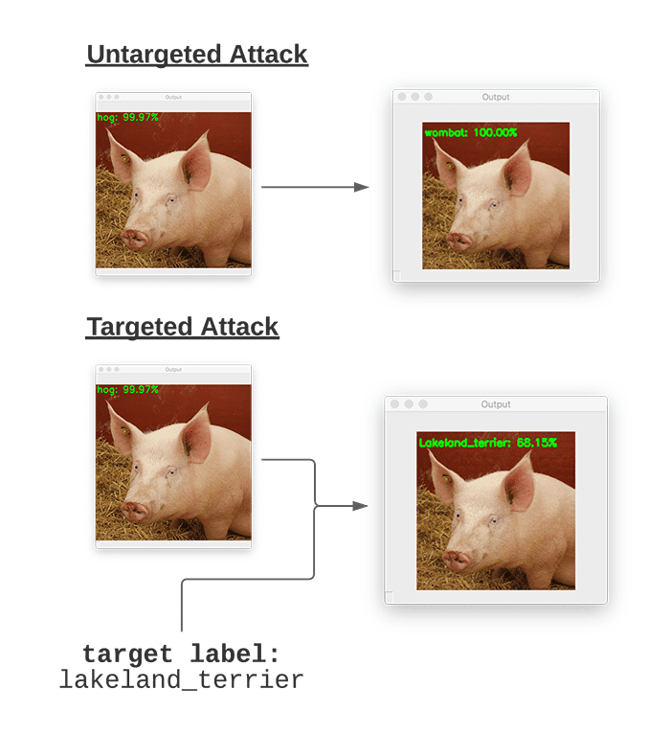
Taxonomy of poisoning attack
Targeted attack vs. Untargeted attack
The goal of targeted attack is to insert hidden triggers in the global model after training, generally by changing specific features.
The goal of untargeted attack is to cause the failure of the global model.
Notes:
Before introducing our model, i will briefly explain about 2 taxonomy of Poisoning attack.
The one is Targeted attack and untargeted attack.
The goal of targeted attack or backdoor is to insert hidden trigger in the global model after training, by changing specific features.
For example, if we add small trigger to this pork image, the model classify pork image as other specific class without degrading overall performance.
The goal of untargeted attack is to cause the failure of the global model. In other words, attacker try to degrade overall performance of global model.
For example, adversaries can use randomly flipped noisy labels to train the model and can send the resulting noisy models to the central server to degrade the overall performance.

Slide 6
Taxonomy of defenses against attacks
Two branches of defense strategies against attacks
Robust Aggregation Strategy using critical weight (ICCV’ 23 + Under review)
Attack Tolerant Local Gradient Update (KDD’ 23)
Notes:
We propose 2 branch of defence strategy against Federated Poisoning Attack.
First one is robust aggregation strategy using critical weight.
Using the difference of critical weight between benign client and malicious client, we detect the malicious clients.
and reduce the learning weight of the malicious clients in global aggregation.
The other one is Attack Tolerant Local Gradient Update by training the local model in robust manner.
It propose the Local Gradient Update that can be used in conjunction with the off-the-shelf global aggregation strategy.
We propose the benign users

Slide 7
Taxonomy of defenses against attacks
Two branches of defense strategies against attacks
Robust Aggregation Strategy using critical weight (ICCV’ 23)
Attack Tolerant Local Gradient Update (KDD’ 23)
Notes:
We propose 2 branch of defence strategy against Federated Poisoning Attack.
First one is robust aggregation strategy using critical weight.
Using the difference of critical weight between benign client and malicious client, we detect the malicious clients.
and reduce the learning weight of the malicious clients in global aggregation.
The other one is Attack Tolerant Local Gradient Update by training the local model in robust manner.
It propose the Local Gradient Update that can be used in conjunction with the off-the-shelf global aggregation strategy.
We propose the benign users

Slide 8
Towards Attack-tolerant Federated Learning via Critical Parameter Analysis (ICCV’23)

Slide 9
Defense strategy for poisoning attack
How to detect and avoid wrong gradients from adversaries?
Two main defense strategies in central server for poisoning attack
Operation-based strategy ex) Median, Trimmed Mean, Residual base: Replace averaging operation in FedAvg with outlier-resistant aggregation
Anomaly detection-based strategy ex) Krum: Find a single honest participant which is probably a good choice for the next round, discarding the data from the rest of the workers. ex) Clustering: Remove outliers after performing clustering algorithm such as DBSCAN, k-means over local gradients. ex) Foolsgold: Investigate pairwise similarities among clients for targeted attack
Notes:
As we said for robust aggregation, we have to distinguish malicious users from benign users.
Then, how to detect them?
We can use outlier-resistant statistics, such as median or trimmed mean in place of simple averaging.
On the other hand, we can also try anomaly detection techniques.
For example, Krum regards an update with minimum Euclidean distances from neighbors as benign users.
We can also apply clustering based method, such as DBSCAN, to detect and remove the outliers.

Slide 10
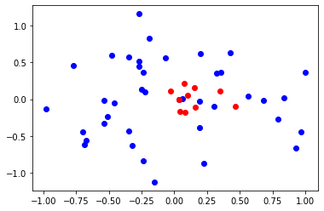
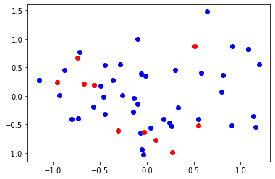
Limitations of existing robust aggregation
Main difficulties in developing robust aggregation
Hard to distinguish benign users with non-IID local data from adversaries.

Slide 11
Main motivation
How to deal with these difficulties?
There would be some common knowledge among benign clients for solving the task… Where does this knowledge reside in the model?
Find model weight which can significantly affect the task, called critical weights.
Adversaries will somehow have different set of critical weights, since they aim to destroy/contaminate the knowledge of global model!
⇒ Extract “critical weights” from models, and compute model similarity over them!
Notes:
To mitigate these issues, in my work, I try to figure out how can we find some common knowledge reside in benign clients.
Even if the local dataset is different due to the data heterogeneity, benign clients share the one common goal for training.
Inspired from the fact that only small part of weight significantly affects for training.
We define these weight which are crucial for optimization as critical weights, and consider these weights are the core part that represents the model’s knowledge.
Then, we hypothesize that adversaries will somehow have different set of critical weights, since they aim to contaminate or inject the malicious knowledge to the model.
In summary, we extract “critical weights” from models, and compute model similarity over them to detect malicious clients.

Slide 12
Finding Critical Weights
Computing the importance of model parameters
Given the dataset S and model weight w, we can denote the loss as L(w, S).
Then, the optimality of L will be achieved at W when ∇L(w, S) = 0.
Let G(t) = L(tw, S), then G’(t) = ∇L(tw, S) * w. If we set t=1, G’(1) = ∇L(w, S) * w.
⇒ The optimality can be checked by exploiting the scalar G’(1)!
C.f) Robust early-learning: Hindering the memorization of noisy labels (ICLR2021)
Notes:
To compute the importance of model parameter, we follow the existing work.
Given the dataset S and model weight w, we can denote the loss as L(w,S).
The optimality of loss can be achieved at W when the ∇L(w, S) become zero.
Here, neural networks are complex. So it makes ∇L(W; S) extremely high-dimensional.
To address this issue, this work applies simple trick as follows.
Using this equation, we can calculate the optimality with a scalar value using G'(1).

Slide 13
Finding Critical Weights
Computing the importance of model parameters
To achieve the optimality, we need to push the value of G’(1) to zero.
⇒ We can judge the importance of each parameter through its influence on G’(1)
Importance = size of learning signal X size of weight (i.e., lottery ticket theorem)
, where
C.f) Robust early-learning: Hindering the memorization of noisy labels (ICLR2021)
Notes:
To achieve the optimality, we need to push the value of G'(1) to be zero.
And this also infers that the importance of each parameter can be judged through its influence on G’(1)
According to our definition, the importance is measured by multiplying the size of gradient and the size of weight.
Intuitively, the size of gradient represents the size of learning signal, and the size of weight represents how large this parameter contributes to the output. This also connects with the lottery ticket theorem.

Slide 14
Observation
Comparison between benign clients’ training
Observation 1. Benign local models tend to have top and bottom important parameters that are similar.
Notes:
Given this importance measurement, we made three observations from our analyses.
First observation is that benign clients tend to share parameters with top-k and bottom-k importance even in non-IID data settings.
In this figure, x-axis is the rank of weight in terms of the importance and y-axis is the changes in their rank after one-round training.
We can figure out that most changes in importance rank are concentrated in parameters with medium importance, whereas the top and bottom parameters tend to remain stable.
This finding suggests different roles for parameters in the model;
The top parameters may be less susceptible to changes due to their significant role in shaping the model’s predictions.
The bottom parameters, on the other hand, contribute only marginally to the predictions and may be neglected during optimization.

Slide 15
Observation
Comparison between benign clients’ training
Observation 2. Poisoned models tend to have different sets of parameters with top and bottom importance compared to benign models.
or induce overfitting
ilar.
Notes:
This experiment is then repeated in the poisoning attack scenario too.
We compare two initialized models derived from the same global model: one is trained with a normal objective and another with a malicious objective.
Then we compute the disparity of the rank changes between normal one and the poisoned one.
Figure (b) here visualizes the results for both untargeted and targeted attack cases.
According to the result, the poisoned model causes greater perturbations in the top and bottom parameters.
This phenomenon may be explained by the fact that a poisoning attack seeks to alter the most critical parameters for disrupting model optimization and injecting malicious information by awakening the least important parameters to cause overfitting to noise.

Slide 16
Observation
Comparison between benign clients’ training
Observation 3. These patterns persist under different levels of data heterogeneity and different datasets.
Notes:
Finally, we examined if this phenomenon holds for various nonIID data settings and datasets.
The level of non-IIDness was adjusted by the beta hyperparameter (β) in the Dirichlet distribution of clients.
Figure 1c above and Figure 3 in the appendix demonstrate that the pattern persists across varying β values and multiple datasets.

Slide 17
Main model
Measuring critical weight overlaps
Given the model weight, compute the importance of parameters.
Then extract the top-k and bottom-k parameters from each client, &
We define the distance metric between client i and j (i, j) as follows
Notes:
Based on our observation, we present an effective defense method against poisoning attacks.
Our key idea is to define a new model similarity metric through critical parameter analysis and measure the normality of each local update based on this similarity.
Then, \model{} aims to filter out and reduce the effect of likely-malicious updates via the attack-tolerant central aggregation.
We describe each procedure in detail
Given the two local models and their parameter importance computed by Eq.~\ref{eq:importance}, we measure the local model similarity by simply comparing the top and bottom sets of parameters, using jaccard distance and spearman correlation.

Slide 18
Main model
Robust central aggregation with the new metric
Compute the distance between clients and average the distance from all clients.
To deal with a Sybil attack, we also consider the distance from the previous round’s global model
Normalize the estimated score to 0~1
Following the existing work (foolsgold), apply the logit function to get weight parameter for robust aggregation (any value exceeding the 0-1 range is clipped).
Overall gradient is computed as follows.
Notes:
Then, we aggregate local updates through a weighted average, with the weight determined in proportion to the normality score.
I’ll skip the details of algorithms, but this allows us to filter out the effect of likely-malicious updates, while preserving the knowledge gained from likely-benign clients' updates.
That was our main model.

Slide 19
Experiments
Targeted attack with dirty labels
Total 20 clients, randomly select 50% of them for every round.
Non-IID with beta distribution, and no overlapped instances exist between local clients
Total 100 communication rounds, 1 local epoch per round.

Slide 20
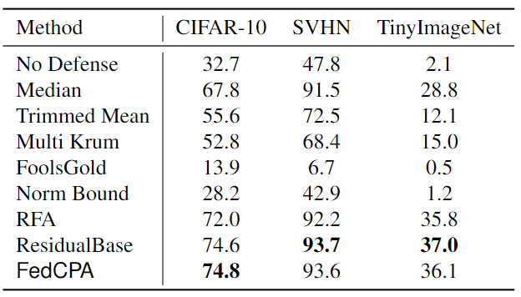
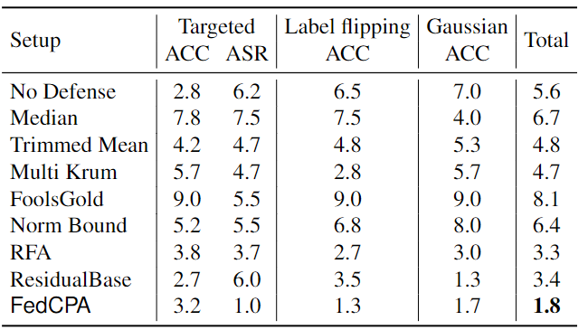
Experiments
Untargeted attack with gaussian noise & Summary

Slide 21
Experiments
Robustness test results

Slide 22
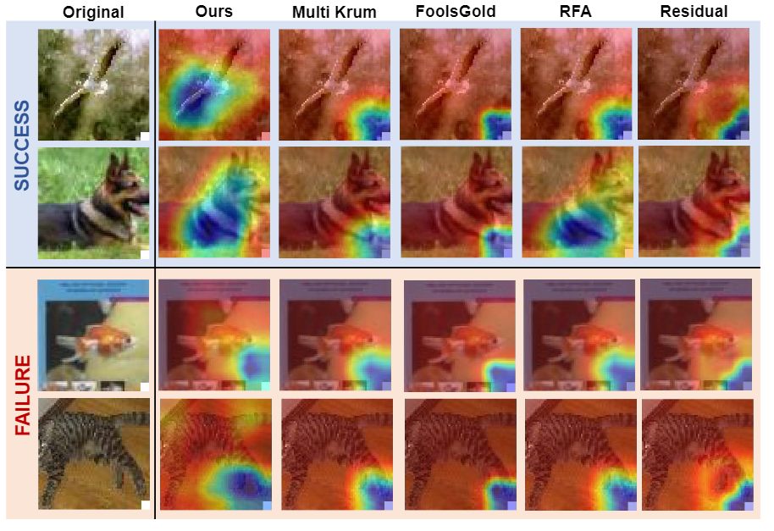
Experiments
Qualitative Analysis

Slide 23
FedDefender: Client-Side Attack-Tolerant
Federated Learning (KDD’ 23)

Slide 24
Taxonomy of defenses against attacks
Two branches of defense strategies against attacks
Robust Aggregation Strategy using critical weight (ICCV’ 23 + Under review)
Attack Tolerant Local Gradient Update (KDD’ 23)
Notes:
We propose 2 branch of defence strategy against Federated Poisoning Attack.
First one is robust aggregation strategy using critical weight.
Using the difference of critical weight between benign client and malicious client, we detect the malicious clients.
and reduce the learning weight of the malicious clients in global aggregation.
The other one is Attack Tolerant Local Gradient Update by training the local model in robust manner.
It propose the Local Gradient Update that can be used in conjunction with the off-the-shelf global aggregation strategy.
We propose the benign users

Slide 25
Motivation
What are the limitations of robust aggregation approaches?
It is difficult to distinguish benign users with non-IID local data distribution from adversaries. If robust aggregation fails to detect, the performance of model can be degraded.
⇒ With this motivation, we propose the Attack Tolerant Local Gradient Update as an add-on module to guarantee additional resistance to model poisoning attack.
Notes:
We think that there are some limitation for existing global aggregation methods.
It is difficult to distinguish benign users with non-IID local data distribution from adversaries.
If robust aggregation fails to detect, the performance of model can be degrade.
However, most existing works focus on robust aggregation strategy.
With this motivation, we propose the Local Gradient Update that can be used as an add-on module for global aggregation strategies to guarantee additional resistance to model poisoning attack.

Slide 26
Main Idea: Client-Side Attack-Tolerant Update
"Vaccinate" local models to thwart model poisoning attack
Attack-tolerant Local Meta Update
learn noise-tolerant parameters in a way that "vaccinates" the local model using meta-update
Attack-tolerant Global Knowledge Distillation
Align the local model’s knowledge to the global data distribution while reducing the adverse effects of the possibly-corrupted global model
Notes:
We propose a unique client-side defense strategy, FedDefender, that vaccinate robust local models to thwart model poisoning attacks in federated learning.
FedDefender comprises the following two steps,
First, Attack-tolerant Local Meta Update and Attack-tolerant Global Knowledge Distillation.
Because of time issue, I skip the detail of the method.

Slide 27
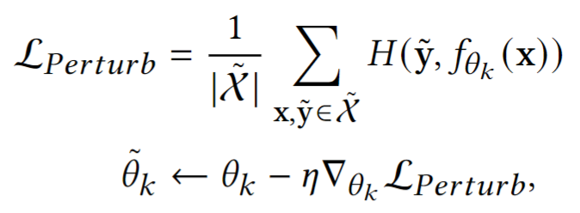
Step 1. Attack-tolerant Local Meta Update
Give vaccine to the local client using meta learning
Generate perturbing batch by replacing the label y with synthetic label
Local model poisoning with synthetic noises
Notes:
Step 1 is Attack-tolerant Local Meta Update.
This process is metaphorically give vaccine to the local client for robust update using meta learning.
If local model parameters 𝜃𝑘 are only optimized with a traditional supervised loss term,
it is prone to being overfit and influenced by noise generated by malicious clients
Our key idea is to learn noise-tolerant parameters 𝜃𝑘 ,
in a way that "vaccinates" the local model 𝑓𝜃𝑘 against model poisoning with synthetic noise using meta learning.
Given mini-batch x, we first perturbing the batch by replacing the original label y with synthetic label y tilde.
Here, we use random instance from top-𝑘 nearest neighbors over the representation space is randomly chosen to replace original label.
We use the similarity based neighbor sampling in order not to break the decision boundaries of the original model too much
Next, local model is poisoned using the perturbed batch x tidle.

Slide 28
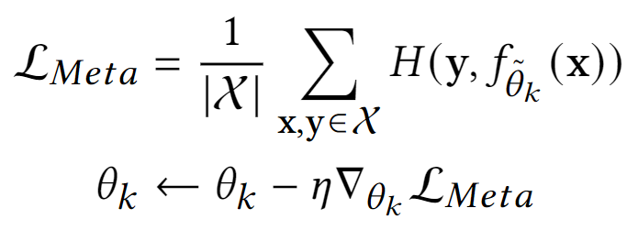
Step 1. Attack-tolerant Local Meta Update
Give vaccine to the local client using meta learning
3. Update local model according to the gradient of Meta loss (meta-learning update)
Notes:
Using this perturbed local model, we calculate the meta loss and original model is updated.
Meta loss is calculated using original label to correct the perturbed local model.
Here, even if loss is calculated by the perturbed local model, original model parameter is updated.
Using this meta update, we can simulated the model poisoning situation and enforce correct result to the perturbed model.

Slide 29
Step 2. Attack-tolerant Global Knowledge Distillation
The credibility of the global model can be compromised
High level feature (ex, fully connected) is more easily overfitting to noise
⇒ Transferring knowledge to an intermediate shallow section of the local model through an auxiliary classifier
C.f) the geometry of generalization and memorization in deep neural networks. (ICLR2021)
Notes:
In federated learning, global knowledge distillation is widely used to regulate the local data bias
from the distribution mismatch between local data global data in the case of non-IID settings.
Given the meta-updated network 𝑓𝜃𝑘 , our next step is to enhance the performance of the refined local model 𝜃𝑘 through global knowledge
distillation.
The thing is that if the global defense fails to block the gradients from hostile clients, global model can be corrupted.
So we can not trust the credibility of the global model.
There is some research that the deeper layer in deep neural networks is much easier to overfit to noise because the the wrong gradient update signal is much stronger in deeper layer.
So we transfer the global knowledge to a shallow intermediate part of the local model to reduce the negative effects of false
information using auxiliary classifier f𝜙𝑘.
To calibrate the global knowledge, we calculate the cosine similarity alpha between global model and local original label.
By linear sum between local label and global model prediction, we refined the label y hat.
we transfer the calibrated global knowledge to auxiliary classifier using these refined label y hat.

Slide 30
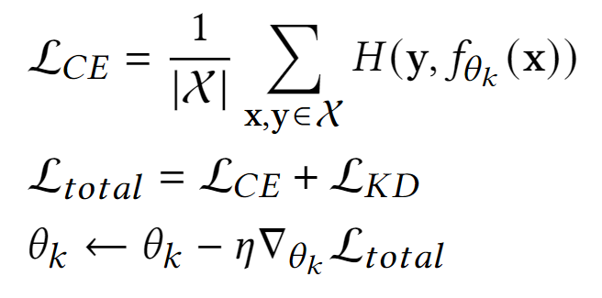
Step 2. Attack-tolerant Global Knowledge Distillation
The credibility of the global model can be compromised
To improve the deeper layers of the local model, we use self knowledge distillation between auxiliary classifier and original classifier.
This global knowledge distillation loss is optimized in conjunction with cross-entropy loss
C.f) the geometry of generalization and memorization in deep neural networks. (ICLR2021)
Notes:
Here, to improve the deeper layers of local model, we use self knowledge distillation between auxiliary classifier and original classifier
because the output from the auxiliary head can be considered as a different augmentation of same instance.
Instead of using global model prediction directly, we can distill the calibrated information by using self knowledge distillation.

Slide 31
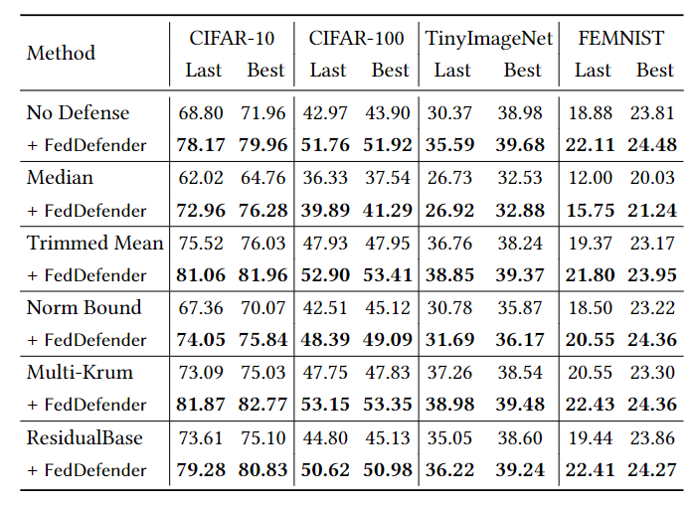
Experiment
(Scenario-1) Attacker cannot access benign clients’ update

Slide 32
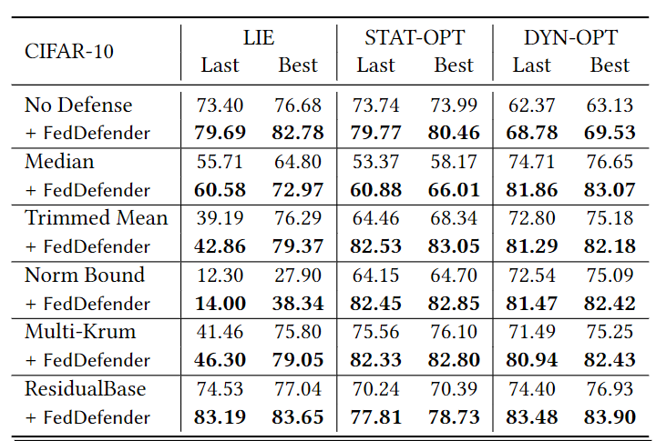
Experiment
(Scenario-2) Attacker can access benign clients’ gradient update partial information

Slide 33
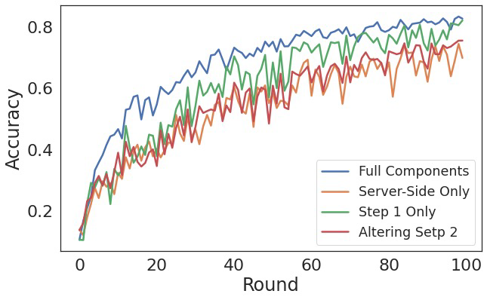
Experiment
Ablation Study

Slide 34
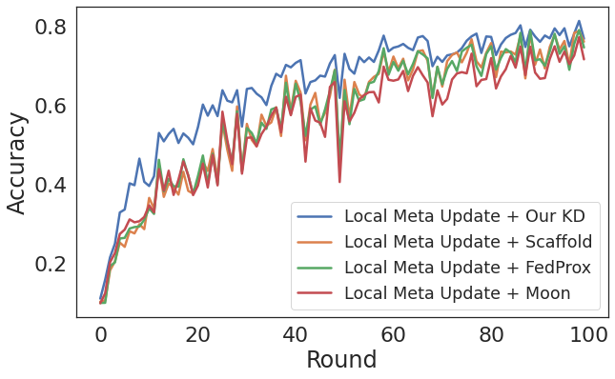
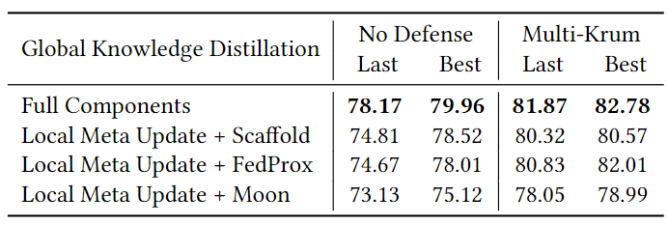
Experiment
Comparison with Other global knowledge distillation (Scaffold, FedProx, Moon)

Slide 35
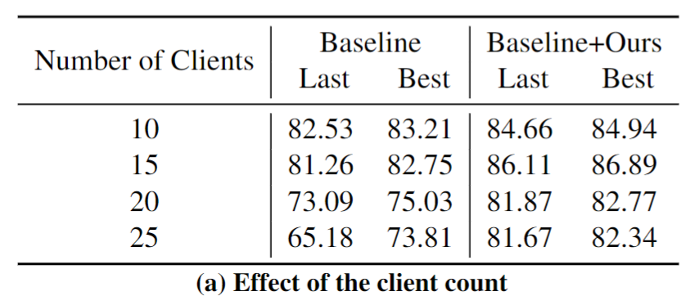
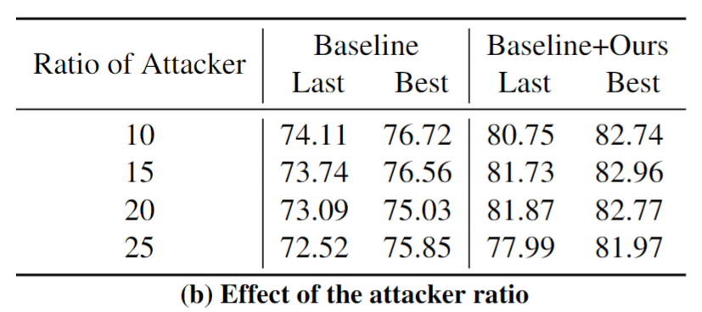
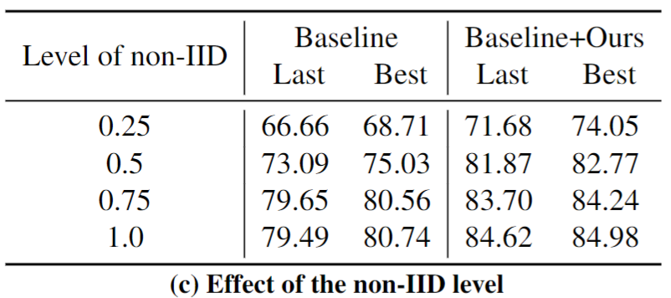
Experiment
Robustness test over various simulation settings

Slide 36
Experiment
Qualitative analyses

Slide 37
Takeaways

Slide 38
Conclusion
Our project proposes effective approaches for both server-side and client-side defense strategies against model poisoning attacks.
Our researches assist practitioners in establishing safer collaboration among distributed participants, mitigating concerns about malicious users disrupting the entire system.
Our methods are independent of the local model’s training strategy. This aspect allows for straightforward integration with a broad array of modules.

Slide 39
Thank you
Sungwon Han (lion4152@gmail.com)
Sungwon Park (deu30303@gmail.com)
Notes:
If you have any questions, please feel free to contact this email address below.
You can also find every code that can build the models presented on this video at this GitHub link.

