Slide 1




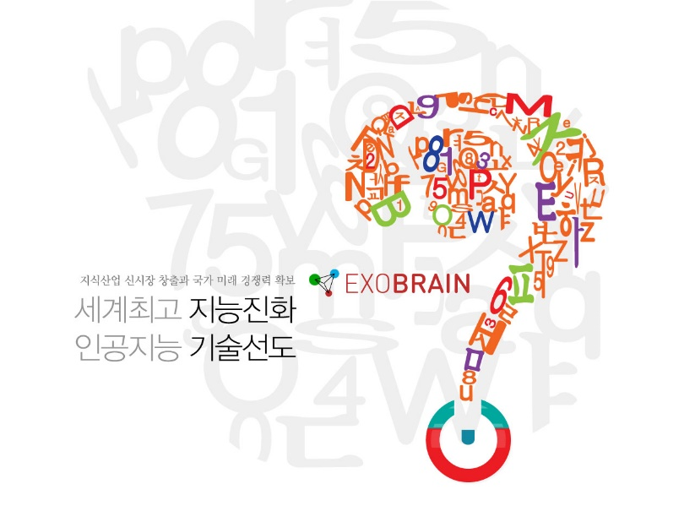
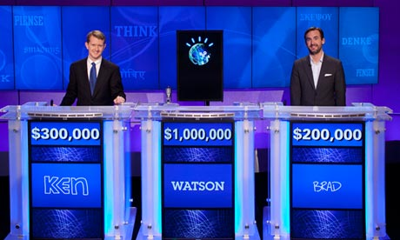

한국어
디비피디아의 자동 스키마
진화를
위한 방법
14.04.20
Introduction
Our Algorithm
Experiment
Conclusion
Sundong Kim
Minseo Kang
Prof. Jae-Gil Lee
KAIST
2014 KIPS 춘계학술발표대회 --- Copyright © 2014 by Sundong Kim, Dept of Industrial & Systems Engineering, KAIST
Notes:
첫 페이지 – 그림들에 대한 간단한 소개.

Slide 2

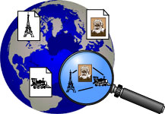











[Three main ontology evolution techniques : Overview]
Knowledge base?
Introduction
Goal: Turn Web into Knowledge base
Comprehensive DB of human knowledge
  Everything that Wikipedia knows
  Everything machine-readable
  Capturing classes, instances, relationships
SUMO
WikiNet
YAGO-NAGA
IWP
Cyc
TextRunner
WikiTaxonomy
ReadTheWeb
2014 KIPS 춘계학술발표대회 --- Copyright © 2014 by Sundong Kim, Dept of Industrial & Systems Engineering, KAIST
Notes:
Dbpedia, Freebase 등 지식 베이스에 대한 간단한 설명

Slide 3
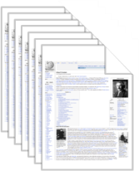
[Three main ontology evolution techniques : Overview]
Knowledge base?
Introduction
Goal: Turn Web into Knowledge base
Comprehensive DB of human knowledge
  Everything that Wikipedia knows
  Everything machine-readable
  Capturing classes, instances, relationships
SUMO
WikiNet
YAGO-NAGA
IWP
Cyc
TextRunner
WikiTaxonomy
ReadTheWeb
2014 KIPS 춘계학술발표대회 --- Copyright © 2014 by Sundong Kim, Dept of Industrial & Systems Engineering, KAIST
Notes:
Dbpedia, Freebase 등 지식 베이스에 대한 간단한 설명

Slide 4
[Three main ontology evolution techniques : Overview]
Knowledge base?
Introduction
Politician Political Party
Angela Merkel CDU
Karl-Theodor zu GuttenbergCDU
Christoph Hartmann FDP
…
Party Spokesperson
CDU Philipp Wachholz
Die Grünen Claudia Roth
Facebook FriendFeed
Software AG IDS Scheer
…
Goal: Turn Web into Knowledge base
Comprehensive DB of human knowledge
  Everything that Wikipedia knows
  Everything machine-readable
  Capturing classes, instances, relationships
Politician Position
Angela Merkel Chancellor Germany
Karl-Theodor zu Guttenberg Minister of Defense Germany
Christoph Hartmann Minister of Economy Saarland
…
Company AcquiredCompany
Google YouTube
Yahoo Overture
Facebook FriendFeed
Software AG IDS Scheer
Company CEO
Google Eric Schmidt
…
Movie ReportedRevenue
Avatar $ 2,718,444,933
The Reader $ 108,709,522
Facebook FriendFeed
Software AG IDS Scheer
…
Actor Award
Christoph Waltz Oscar
Sandra Bullock Oscar
Sandra Bullock Golden Raspberry
…
SUMO
WikiNet
YAGO-NAGA
IWP
Cyc
TextRunner
WikiTaxonomy
ReadTheWeb
2014 KIPS 춘계학술발표대회 --- Copyright © 2014 by Sundong Kim, Dept of Industrial & Systems Engineering, KAIST
Notes:
Dbpedia, Freebase 등 지식 베이스에 대한 간단한 설명

Slide 5
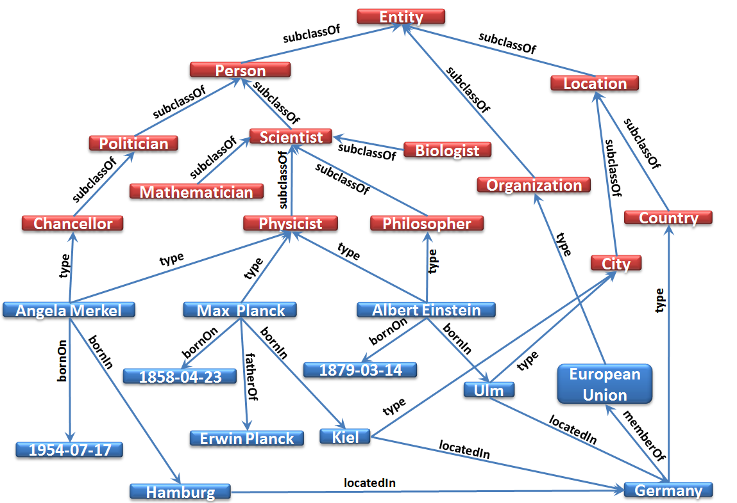










[Three main ontology evolution techniques : Overview]
Knowledge base?
Introduction
Goal: Turn Web into Knowledge base
Comprehensive DB of human knowledge
  Everything that Wikipedia knows
  Everything machine-readable
  Capturing classes, instances, relationships
SUMO
WikiNet
YAGO-NAGA
IWP
Cyc
TextRunner
WikiTaxonomy
ReadTheWeb
2014 KIPS 춘계학술발표대회 --- Copyright © 2014 by Sundong Kim, Dept of Industrial & Systems Engineering, KAIST
Notes:
Dbpedia, Freebase 등 지식 베이스에 대한 간단한 설명

Slide 6


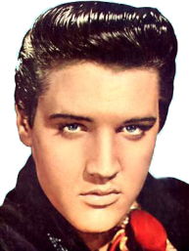
[Three main ontology evolution techniques : Overview]
DBpedia
Introduction
Started in 2007, driven by Freie U. Berlin, U. Leipzig, OpenLinkTurn Web into Knowledge base
Instances: 4,004,478
manual
Person
Human
from YAGO
{{infobox Elvis Presley
altName: The King
birthDate: 1935
Occupation: Singer
Singer
American artist
birthDate, dateofBirth,… → born
altName
born
The King
1935
All infobox attributes
In a separate space:
Attributes with manual patterns
2014 KIPS 춘계학술발표대회 --- Copyright © 2014 by Sundong Kim, Dept of Industrial & Systems Engineering, KAIST
Notes:
한국어 디비피디아의 특징? 어떻게 만들어졌나

Slide 7
[Three main ontology evolution techniques : Overview]
DBpedia Overview
Introduction
Content | Entities of public interest
Format | OWL, RDF, API, SPARQL
Sources | Wikipedia, YAGO/WordNet
Main strengths | Focus on coverage, interlinking with other data sets
Technique | Extraction from Wikipedia + manual supervision by the community
Size | Instances: 4,004,478 (Person: 831,558 - Places: 639,450 - Work: 372,226 - Organizations: 209,471) Raw Properties: 51,736 Manual Classes: 556
License | CC-BY-SA & GNU F이
URL | http://dbpedia.org
Reference | [Auer, ISWC 2007], [Bizer09, JWS 2009]
http://wiki.dbpedia.org/Datasets39/DatasetStatistics?v=dqp
2014 KIPS 춘계학술발표대회 --- Copyright © 2014 by Sundong Kim, Dept of Industrial & Systems Engineering, KAIST
Notes:
한국어 디비피디아의 특징? 어떻게 만들어졌나

Slide 8
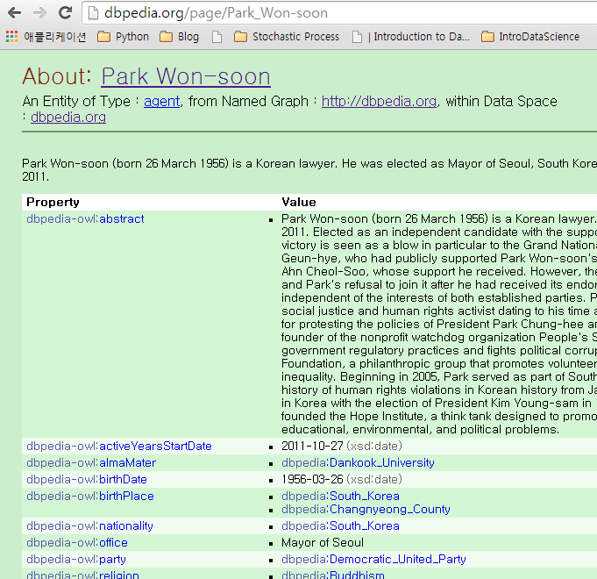
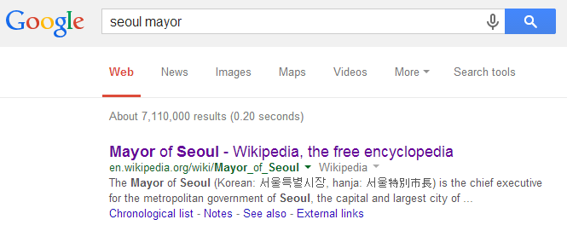

[Three main ontology evolution techniques : Overview]
SPARQL
Introduction
How can we use structured data?
  By using Query language SPARQL for RDF from the W3C
  http://dbpedia.org/sparql?query=select * where {<http://dbpedia.org/resource/Seoul> <http://dbpedia.org/ontology/leaderName> ?p}
2014 KIPS 춘계학술발표대회 --- Copyright © 2014 by Sundong Kim, Dept of Industrial & Systems Engineering, KAIST
Notes:
OWL, RDF 등 기본적인 온톨로지 구성에 대한 정보

Slide 9


[Three main ontology evolution techniques : Overview]
SPARQL examples
Introduction
  http://ko.dbpedia.org/sparql?query=select * where {<http://ko.dbpedia.org/resource/이희호> <http://ko.dbpedia.org/property/배우자> ?p}
  http://dbpedia.org/sparql?query=select * where {<http://dbpedia.org/resource/Assembly_Bill_811> <http://dbpedia.org/property/governor> ?p}
2014 KIPS 춘계학술발표대회 --- Copyright © 2014 by Sundong Kim, Dept of Industrial & Systems Engineering, KAIST
Notes:
OWL, RDF 등 기본적인 온톨로지 구성에 대한 정보

Slide 10
[Three main ontology evolution techniques : Overview]
Application – QA system
Introduction
IBM Watson
Exobrain Project
http://www.ibm.com/smarterplanet/us/en/ibmwatson/
http://exobrain.kr/
2014 KIPS 춘계학술발표대회 --- Copyright © 2014 by Sundong Kim, Dept of Industrial & Systems Engineering, KAIST
Notes:
OWL, RDF 등 기본적인 온톨로지 구성에 대한 정보

Slide 11



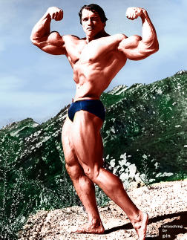

[Three main ontology evolution techniques : Overview]
Intuition
Introduction
Arnold_Schwarzenegger type changes
  Person → BodyBuilder → Actor → Politician → ???
Subject | Predicate | Object
http://dbpedia.org/resource/Arnold_Schwarzenegger | http://dbpedia.org/ontology/birthPlace | http://dbpedia.org/resource/Austria
http://dbpedia.org/resource/Arnold_Schwarzenegger | http://dbpedia.org/ontology/almaMater | http://dbpedia.org/resource/University_of_Wisconsin
http://dbpedia.org/resource/Arnold_Schwarzenegger | http://purl.org/dc/terms/subject | http://dbpedia.org/resource/Category:American_bodybuilders
http://dbpedia.org/resource/Twins_(1988_film) | http://dbpedia.org/ontology/starring | http://dbpedia.org/resource/Arnold_Schwarzenegger
http://dbpedia.org/resource/I'll_be_back | http://dbpedia.org/property/actor | http://dbpedia.org/resource/Arnold_Schwarzenegger
http://dbpedia.org/resource/Arnold_Schwarzenegger | http://dbpedia.org/ontology/office | Governor of California
http://dbpedia.org/resource/Arnold_Schwarzenegger | http://dbpedia.org/ontology/activeYearsStartDate | 2003-11-17
http://dbpedia.org/resource/Arnold_Schwarzenegger | http://dbpedia.org/ontology/orderInOffice | 38th
http://dbpedia.org/resource/Arnold_Schwarzenegger | http://dbpedia.org/ontology/activeYearsEndDate | 2011-01-03
2014 KIPS 춘계학술발표대회 --- Copyright © 2014 by Sundong Kim, Dept of Industrial & Systems Engineering, KAIST
Notes:
시간에 따른 변화 설명

Slide 12
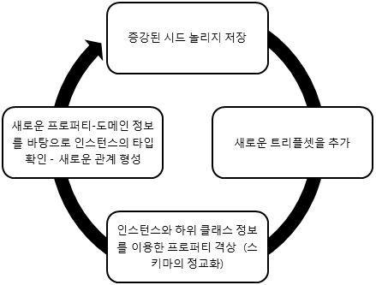
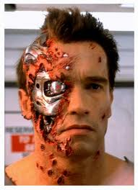
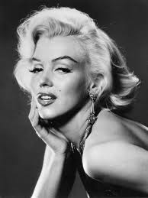
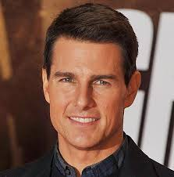
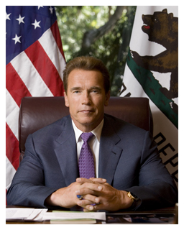

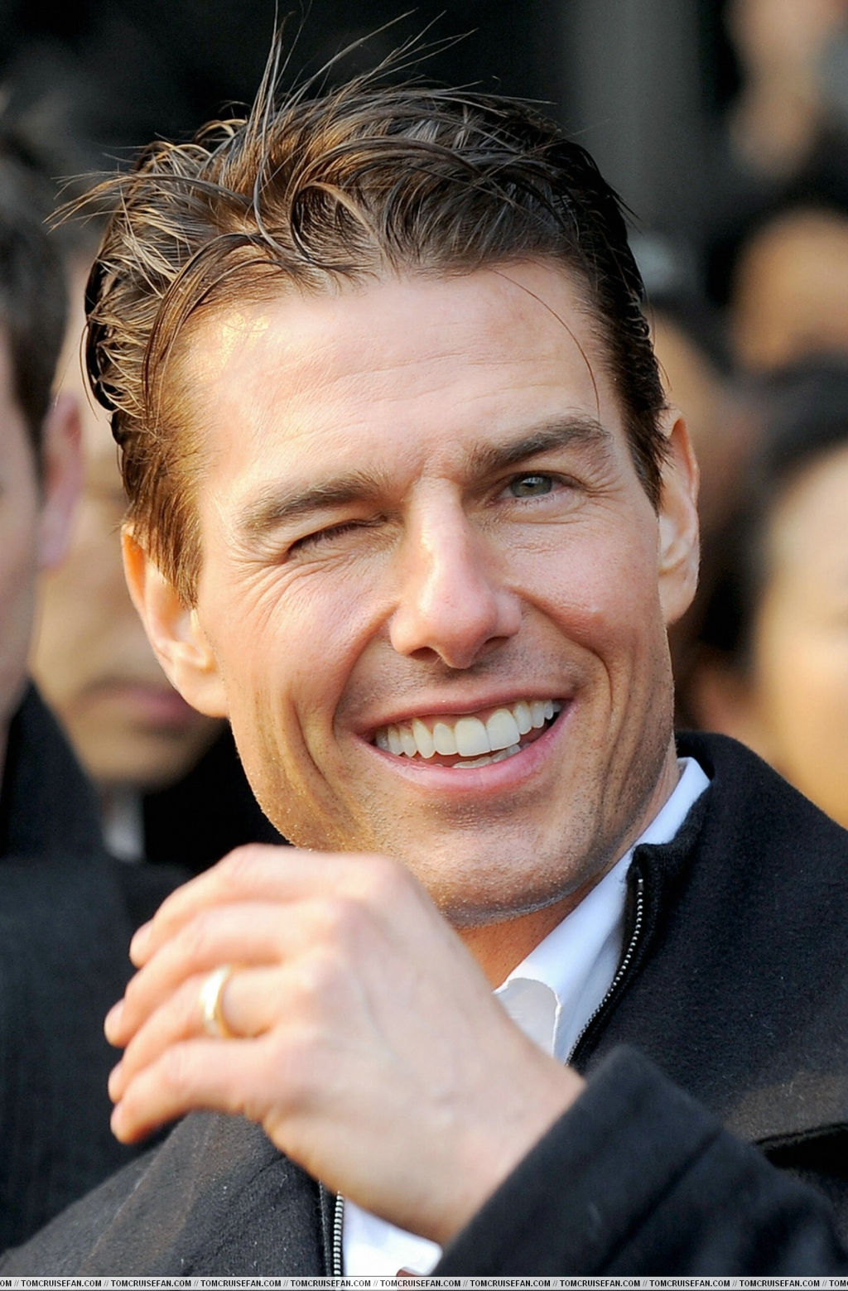
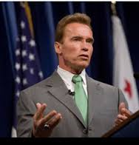
[Three main ontology evolution techniques : Overview]
Ontology learning
Introduction
Person
Actor
Actor
Politician
Actor
Politician
2014 KIPS 춘계학술발표대회 --- Copyright © 2014 by Sundong Kim, Dept of Industrial & Systems Engineering, KAIST
Notes:
온톨로지 증강

Slide 13
[Three main ontology evolution techniques : Overview]
Ontology learning
Introduction
Our Goal: Learning Knowledge base in fully-automated way
Input
  Basic Knowledge base – Predefined Ontology and property
  Validated triple set
Output
  Updated Knowledge base
Method
  Analyzing property information of instance
  Property Generalization
  Instance type correction
2014 KIPS 춘계학술발표대회 --- Copyright © 2014 by Sundong Kim, Dept of Industrial & Systems Engineering, KAIST
Notes:
온톨로지 증강

Slide 14
[Three main ontology evolution techniques : Overview]
Related work
Introduction
Ontology evolution: L. Stojanovic., "Methods and tools for ontology evolution," Ph.D. dissertation, Vrije Universiteit in Amsterdam, Netherlands, 2004.
  Data-driven approach
  User-driven approach
  Structure-driven approach
Airpedia: A. Aprosio et al., "Extending the Coverage of DBpedia Properties using Distant Supervision over Wikipedia,”Proceedings of the 1st Workshop on NLP & DBpedia (ISWC), 2013.
  Update localized DBpedia by analyze other countries DBpedia and Wikipedia infobox value.
2014 KIPS 춘계학술발표대회 --- Copyright © 2014 by Sundong Kim, Dept of Industrial & Systems Engineering, KAIST
Notes:
보강 필요.

Slide 15
[Three main ontology evolution techniques : Overview]
Basic learning function
Introduction
Our algorithm
Add triple information into knowledge base
  If instance is new, create the instance
  If class is new, create the class
  If property is new, create the property
  If subject has various rdf:type information, put it into the most specific class
2014 KIPS 춘계학술발표대회 --- Copyright © 2014 by Sundong Kim, Dept of Industrial & Systems Engineering, KAIST

Slide 16
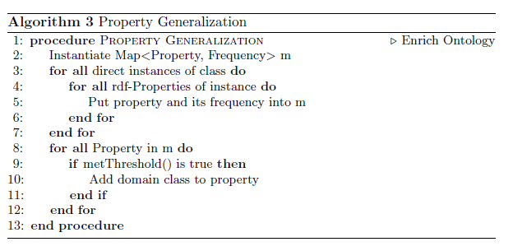
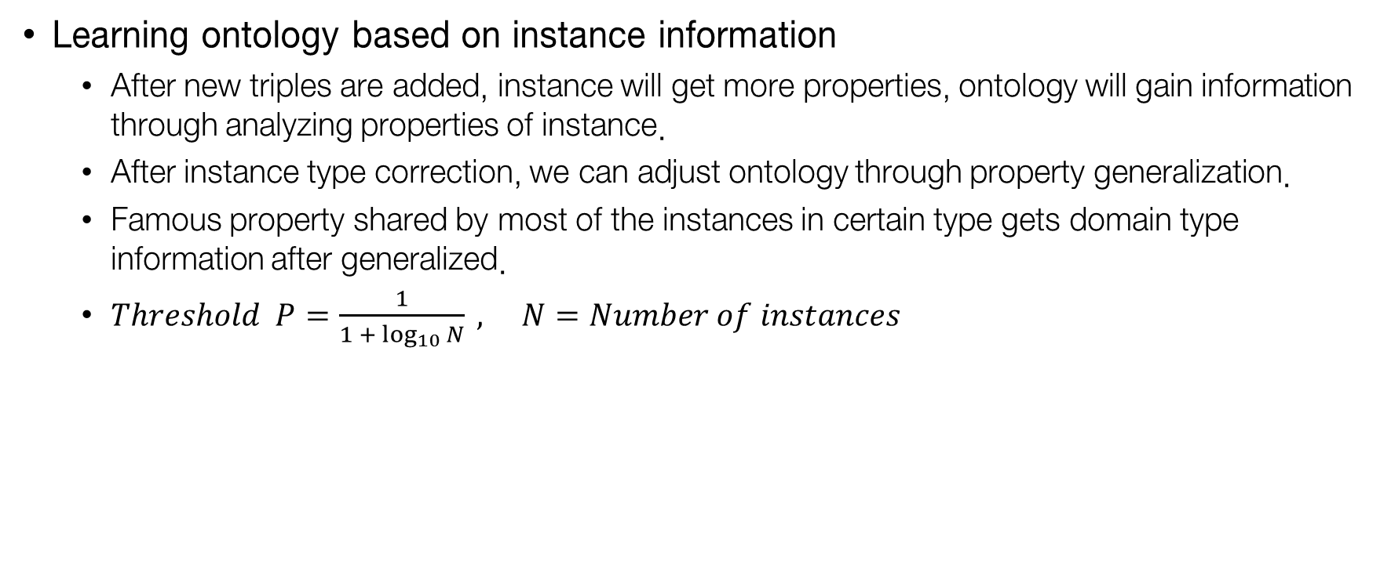
[Three main ontology evolution techniques : Overview]
Property Generalization
Introduction
Our algorithm
Learning ontology based on instance information
  After new triples are added, instance will get more properties, ontology will gain information through analyzing properties of instance.
  After instance type correction, we can adjust ontology through property generalization.
  Famous property shared by most of the instances in certain type gets domain type information after generalized.
  $Threshold P=\frac{1}{1 +\log_{10}{N}} , N=Number of instances$
2014 KIPS 춘계학술발표대회 --- Copyright © 2014 by Sundong Kim, Dept of Industrial & Systems Engineering, KAIST

Slide 17
[Three main ontology evolution techniques : Overview]
Property Generalization
Introduction
Our algorithm
Original Knowledge base
  Hierarchy : 사람 – 군주_정보
  Instance : 고려_신종, 고려_안종, 고려_경종, 고려_충렬왕
사람
이름, 종교
군주_정보
재위, 모후, 다음왕, 왕비, 모비, 임기, 후임자
고려_신종
고려_안종
고려_경종
고려_충렬왕
subclassOf
type
type
type
type
이름 : 고려_신종
종교 : 불교
재위 : 1197
모후 : 공예왕후
다음왕 : 고려_희종
부왕 : 고려_인종
이름 : 고려_안종
왕비 : 헌정왕후
모비 : 신성왕후
부왕 : 고려_태조
목록 : 고려의_역대_국왕
이름 : 고려_경종
종교 : 불교
재위 : 975
모후 : 대목왕후
왕후 : 헌숙왕후
부왕 : 고려_광종
이름 : 고려_충렬왕
종교 : 불교
임기 : 1299
왕비 : 제국대장공주
부왕 : 고려_원종
이전왕 : 고려_충선왕
2014 KIPS 춘계학술발표대회 --- Copyright © 2014 by Sundong Kim, Dept of Industrial & Systems Engineering, KAIST

Slide 18
[Three main ontology evolution techniques : Overview]
Property Generalization
Introduction
Our algorithm
New triple is added to the knowledge base
  Instance : 고려_순종
  rdf:type : 군주_정보
  Property : 이름, 종교, 임기, 후임자, 모후, 부왕
사람
이름, 종교
군주_정보
재위, 모후, 다음왕, 왕비, 모비, 임기, 후임자
고려_신종
고려_안종
고려_경종
고려_충렬왕
고려_순종
이름 : 고려_신종
종교 : 불교
재위 : 1197
모후 : 공예왕후
다음왕 : 고려_희종
부왕 : 고려_인종
이름 : 고려_안종
왕비 : 헌정왕후
모비 : 신성왕후
부왕 : 고려_태조
목록 : 고려의_역대_국왕
이름 : 고려_경종
종교 : 불교
재위 : 975
모후 : 대목왕후
왕후 : 헌숙왕후
부왕 : 고려_광종
이름 : 고려_충렬왕
종교 : 불교
임기 : 1299
왕비 : 제국대장공주
부왕 : 고려_원종
이전왕 : 고려_충선왕
이름 : 고려_순종
종교 : 불교
임기 : 1083
후임자 : 고려_선종
모후 : 인예왕후
부왕 : 고려_문종
2014 KIPS 춘계학술발표대회 --- Copyright © 2014 by Sundong Kim, Dept of Industrial & Systems Engineering, KAIST

Slide 19

[Three main ontology evolution techniques : Overview]
Property Generalization
Introduction
Our algorithm
Property ‘부왕’ is frequent.
  $Frequency=1>0.5885=\frac{1}{1 +\log_{10}{N}}$
사람
이름, 종교
군주_정보
재위, 모후, 다음왕, 왕비, 모비, 임기, 후임자
고려_신종
고려_안종
고려_경종
고려_충렬왕
고려_순종
이름 : 고려_신종
종교 : 불교
재위 : 1197
모후 : 공예왕후
다음왕 : 고려_희종
부왕 : 고려_인종
이름 : 고려_안종
왕비 : 헌정왕후
모비 : 신성왕후
부왕 : 고려_태조
목록 : 고려의_역대_국왕
이름 : 고려_경종
종교 : 불교
재위 : 975
모후 : 대목왕후
왕후 : 헌숙왕후
부왕 : 고려_광종
이름 : 고려_충렬왕
종교 : 불교
임기 : 1299
왕비 : 제국대장공주
부왕 : 고려_원종
이전왕 : 고려_충선왕
이름 : 고려_순종
종교 : 불교
임기 : 1083
후임자 : 고려_선종
모후 : 인예왕후
부왕 : 고려_문종
2014 KIPS 춘계학술발표대회 --- Copyright © 2014 by Sundong Kim, Dept of Industrial & Systems Engineering, KAIST

Slide 20
[Three main ontology evolution techniques : Overview]
Property Generalization
Introduction
Our algorithm
Ontology information is refined
  Property ‘부왕’gets domain ‘군주_정보’
사람
이름, 종교
군주_정보
재위, 모후, 다음왕, 왕비, 모비, 임기, 후임자, 부왕
고려_신종
고려_안종
고려_경종
고려_충렬왕
고려_순종
이름 : 고려_신종
종교 : 불교
재위 : 1197
모후 : 공예왕후
다음왕 : 고려_희종
부왕 : 고려_인종
이름 : 고려_안종
왕비 : 헌정왕후
모비 : 신성왕후
부왕 : 고려_태조
목록 : 고려의_역대_국왕
이름 : 고려_경종
종교 : 불교
재위 : 975
모후 : 대목왕후
왕후 : 헌숙왕후
부왕 : 고려_광종
이름 : 고려_충렬왕
종교 : 불교
임기 : 1299
왕비 : 제국대장공주
부왕 : 고려_원종
이전왕 : 고려_충선왕
이름 : 고려_순종
종교 : 불교
임기 : 1083
후임자 : 고려_선종
모후 : 인예왕후
부왕 : 고려_문종
2014 KIPS 춘계학술발표대회 --- Copyright © 2014 by Sundong Kim, Dept of Industrial & Systems Engineering, KAIST

Slide 21


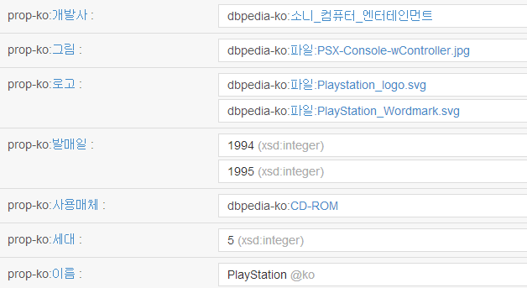
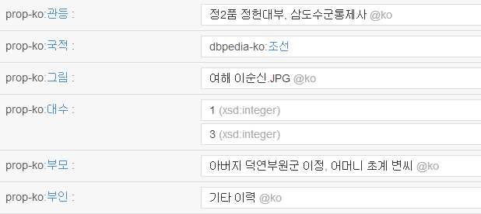

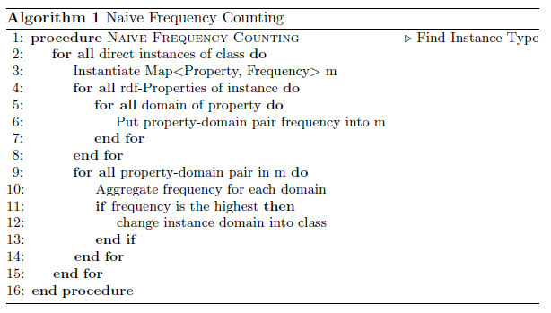
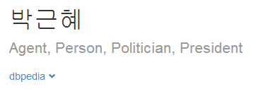
[Three main ontology evolution techniques : Overview]
Instance type finding
Introduction
Our algorithm
‘rdf:type’ information in DBpedia is not always true.
  Some instance has various property that can’t be categorized in one type.
  ’rdf:type’ data could be missed while creating instance.
  Natural-language processing procedure simply can’t find instance’s type.
  Correct type information is needed to apply data-driven approach (property generalization).
2014 KIPS 춘계학술발표대회 --- Copyright © 2014 by Sundong Kim, Dept of Industrial & Systems Engineering, KAIST

Slide 22
[Three main ontology evolution techniques : Overview]
Instance type finding – By property information
Introduction
Our algorithm
Property Analysis of DBpedia instance ‘김대중’
Property Name | # of Domains | Domain class
prop-ko:이름 | 101 | ‘국가원수_정보’, ‘인물_정보’
prop-ko:그림 | 61 | ‘예술가_정보’, ‘인물_정보’
prop-ko:국가 | 34 | ‘대통령_정보’, ‘공직자_정보’
prop-ko:설명 | 33 | ‘국가원수_정보’, ‘모델_정보’
prop-ko:출생지 | 31 | ‘국가원수_정보’, ‘군주_정보’
prop-ko:사망일 | 29 | ‘왕_정보’, ‘국가원수_정보’
prop-ko:출생일 | 28 | ‘대통령_정보’, ‘군주_정보’
prop-ko:사망지 | 28 | ‘군주_정보’, ‘인물_정보’
… | … | …
prop-ko:취임일 | 2 | ‘국가원수_정보’, ‘대통령_정보’
prop-ko:부통령명칭 | 1 | ‘국가원수_정보’
Domain Name | Frequency
‘국가원수_정보’ | 25
‘대통령_정보’ | 16
‘작가_정보’ | 16
‘공직자_정보’ | 15
‘정치인_정보’ | 14
‘군주_정보’ | 14
‘왕_정보’ | 11
‘공무원_정보’ | 9
2014 KIPS 춘계학술발표대회 --- Copyright © 2014 by Sundong Kim, Dept of Industrial & Systems Engineering, KAIST

Slide 23
[Three main ontology evolution techniques : Overview]
Our dataset
Introduction
Our algorithm
Experiment
Korean DBpedia Construction
  Create Korean DBpedia Knowledge base by referring English DBpedia, Korean-English mapping information
  Add Mapping-based properties, and only Korean-available properties.
  All properties are added as datatype property.
  BFS-Crawled instance CSV file from http://ko.dbpedia.org/직업별_조선_사람.
  Collected 30,000 instance files – 18,305 instances have property.
  Only considered the triple that the instance is equal to subject (Not object).
  Among the rdf:type information, the deepest class in ontology hierarchy is selected as a instance type for further evolution.
2014 KIPS 춘계학술발표대회 --- Copyright © 2014 by Sundong Kim, Dept of Industrial & Systems Engineering, KAIST

Slide 24
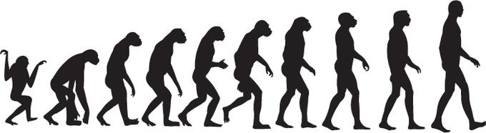
[Three main ontology evolution techniques : Overview]
Experiment
Introduction
Our algorithm
Experiment
Add instance without Evolution
Original DBpedia Ontology
DBpedia Knowledge base
Same 18,305 instances
Original DBPedia ontology
Add instance
Add instance
Add instance
Evolved Knowledge base
2014 KIPS 춘계학술발표대회 --- Copyright © 2014 by Sundong Kim, Dept of Industrial & Systems Engineering, KAIST

Slide 25
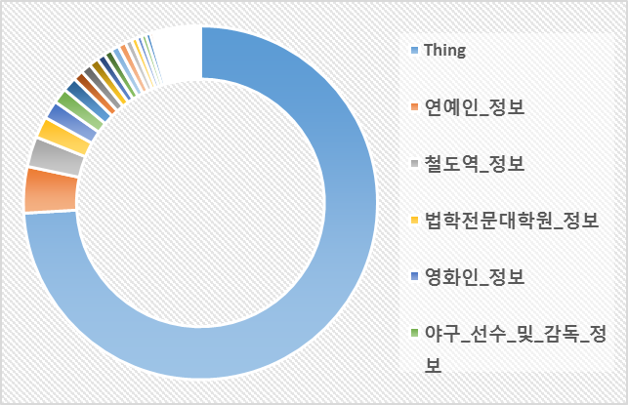
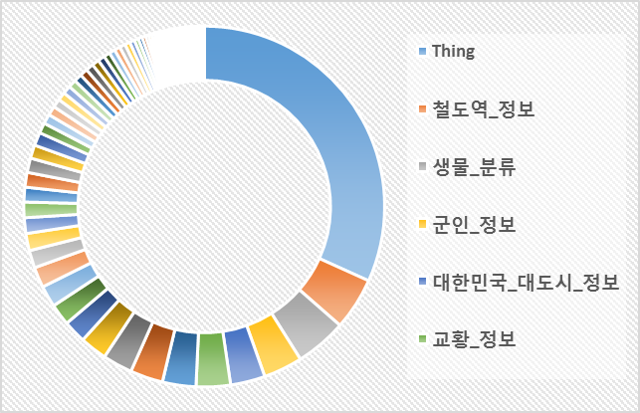
[Three main ontology evolution techniques : Overview]
Result
Introduction
Our algorithm
Experiment
Unclassified instance decreases significantly (74% → 32%)
Number of class more than 100 instances (14 → 35)
2014 KIPS 춘계학술발표대회 --- Copyright © 2014 by Sundong Kim, Dept of Industrial & Systems Engineering, KAIST
Notes:
With Algorithm vs without algorithm

Slide 26
[Three main ontology evolution techniques : Overview]
Conclusion
Introduction
Our algorithm
Experiment
Classify DBpedia instance better than before
Need verified RDF triple
Fully-automated
Ontology Learning
Overfit
Can be applied to other knowledge base
Naive Algorithm
<Contribution>
<Weakness>
2014 KIPS 춘계학술발표대회 --- Copyright © 2014 by Sundong Kim, Dept of Industrial & Systems Engineering, KAIST

Slide 27
[Three main ontology evolution techniques : Overview]
Further work
Introduction
Our algorithm
Experiment
Conclusion
Elaboration of our algorithm
  Connect between property generalization and type recorrection
  Cosine similarity measure
  TF-IDF measure while counting property frequency.
  Adopt topic modeling methods to our research
Ground truth – to validate our algorithm
  Crowdsourcing is not enough for validate new information.
  Finding type information through Korean Wordnet, other resources.
2014 KIPS 춘계학술발표대회 --- Copyright © 2014 by Sundong Kim, Dept of Industrial & Systems Engineering, KAIST
Notes:
Further work

Slide 28
[Three main ontology evolution techniques : Overview]
Reference
Introduction
Our algorithm
Experiment
Conclusion
Ontology Learning
  L. Stojanovic., "Methods and tools for ontology evolution," Ph.D. dissertation, Vrije Universiteit in Amsterdam, Netherlands, 2004.
DBpedia
  J. Lehmann, R. Isele, M. Jakob, A. Jentzsch, D. Kontokostas, P. N. Mendes, S. Hellmann, M. Morsey, P. Kleef, S. Auer, C. Bizer, “DBpedia – A large scale, multilingual knowledge base extracted from Wikipedia.”Semantic Web 1, 1-5, 2012.
  Airpedia: A. Aprosio et al., "Extending the Coverage of DBpedia Properties using Distant Supervision over Wikipedia,”Proceedings of the 1st Workshop on NLP & DBpedia (ISWC), 2013.
2014 KIPS 춘계학술발표대회 --- Copyright © 2014 by Sundong Kim, Dept of Industrial & Systems Engineering, KAIST

Slide 29
[Three main ontology evolution techniques : Overview]
Appendix (Park_Won-soon)
Introduction
Subject | Predicate | Object
http://dbpedia.org/resource/Park_Won-soon | http://www.w3.org/1999/02/22-rdf-syntax-ns#type | http://dbpedia.org/ontology/Person
http://dbpedia.org/resource/Park_Won-soon | http://www.w3.org/1999/02/22-rdf-syntax-ns#type | http://dbpedia.org/ontology/OfficeHolder
http://dbpedia.org/resource/Park_Won-soon | http://www.w3.org/1999/02/22-rdf-syntax-ns#type | http://dbpedia.org/ontology/Agent
http://dbpedia.org/resource/Park_Won-soon | http://dbpedia.org/ontology/abstract | Park Won-soon (born 26 March 1956) is a Korean lawyer...
http://dbpedia.org/resource/Park_Won-soon | http://dbpedia.org/ontology/religion | http://dbpedia.org/resource/Buddhism
http://dbpedia.org/resource/Park_Won-soon | http://dbpedia.org/property/almaMater | http://dbpedia.org/resource/Dankook_University
http://dbpedia.org/resource/Park_Won-soon | http://dbpedia.org/property/birthDate | 1956-03-26
http://dbpedia.org/resource/Park_Won-soon | http://dbpedia.org/property/birthPlace | http://dbpedia.org/resource/South_Korea
http://dbpedia.org/resource/Park_Won-soon | http://dbpedia.org/property/birthPlace | http://dbpedia.org/resource/Changnyeong_County
http://dbpedia.org/resource/Park_Won-soon | http://dbpedia.org/property/hangul | 박원순
http://dbpedia.org/resource/Park_Won-soon | http://dbpedia.org/property/nationality | http://dbpedia.org/resource/South_Korea
http://dbpedia.org/resource/Park_Won-soon | http://dbpedia.org/property/office | http://dbpedia.org/resource/Mayor_of_Seoul
http://dbpedia.org/resource/Park_Won-soon | http://dbpedia.org/property/party | http://dbpedia.org/resource/Democratic_United_Party
http://dbpedia.org/resource/Park_Won-soon | http://dbpedia.org/property/placeOfBirth | http://dbpedia.org/resource/Changnyeong_County
http://dbpedia.org/resource/Park_Won-soon | http://dbpedia.org/property/placeOfBirth | http://dbpedia.org/resource/South_Korea
http://dbpedia.org/resource/Seoul | http://dbpedia.org/ontology/leaderName | http://dbpedia.org/resource/Park_Won-soon
Meary
2014 KIPS 춘계학술발표대회 --- Copyright © 2014 by Sundong Kim, Dept of Industrial & Systems Engineering, KAIST
Notes:
온톨로지 만지는 툴인 Protégé 설명

